Slide 1
Metaheuristic Algorithms to Balance Robotic Assembly Lines
S. G. PONNAMBALAM
Professor
School of Engineering
Monash University Malaysia
sgponnambalam@monash.edu

Slide 2
Outline
Supply chain and ALB
Introduction to ALB
Types of ALB
Literature
RAL
Metaheuristic Algorithms
Q & A

Slide 3
SCM Decisions
Strategic Decisions:
allocation and opening of facilities
design of the distribution network
Tactical Decisions:
Manufacturing/Assembly of products
Assembly line balancing
warehousing

Slide 4
Introduction
Assembly Line – first developed by Ford Motor Company in 1900s.
Ford installed the first moving assembly line.
His innovation reduced the time it took to assemble a chassis from more than 12 hours to two hours and 30 minutes.
What is meant by Balancing?
The process of equalizing the amount of work at each workstation on an assembly line.
To work effectively, with no work pile-ups between stations, the line must be balanced.

Slide 5
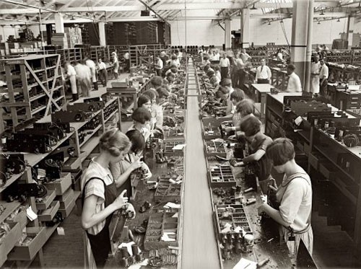
Introduction
Assembly Line Balancing is a classical optimization problem.
Assembly Line Balancing can ensure………..
Improvement of:
efficiency
production rate
productivity
Reduction of:
idle time
resource utilization
production cost

Slide 6

Unbalance Issues
Overproduction which causes wastes
Over-processing
Inventory
Waiting
Transportation
5 mins
25 mins
15 mins
10 mins
1
2
3
4
This operator must WAIT for operator 2
This operator must WAIT for operator 3
Constraint
Overburden
25
20
mins
15
10
5
1
2
Station
3
4

Slide 7
Line Balance : Simple Example
Promotes one-piece FLOW
Avoids overburden
Minimizes wastes
15 mins
15 mins
15 mins
10 mins
1
2
3
4
Redistribute the work
25
20
Time (mins)
15
10
5
Stations

Slide 8
Classification of ALB Problems
ALB was first mathematically formulated by Helgeson in 1954.
ALB Types
Model Type
Single Model
Multi Model
Problem Structure
Simple ALB
Mixed Model
SALB-I
SALB-II
General ALB
RALB
FALB

Slide 9

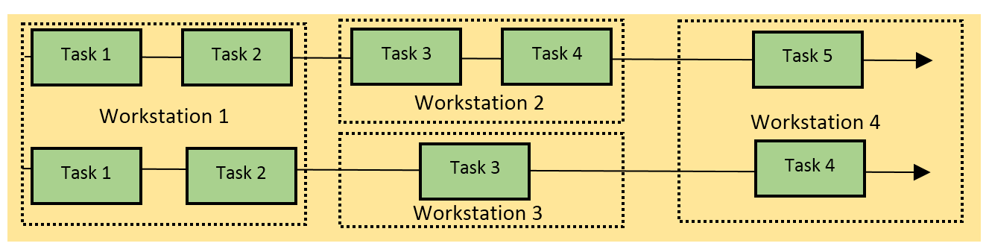
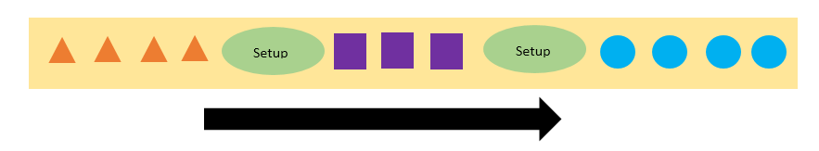
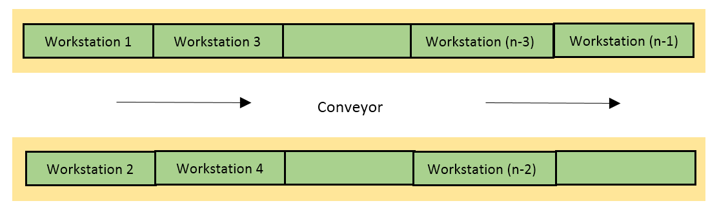

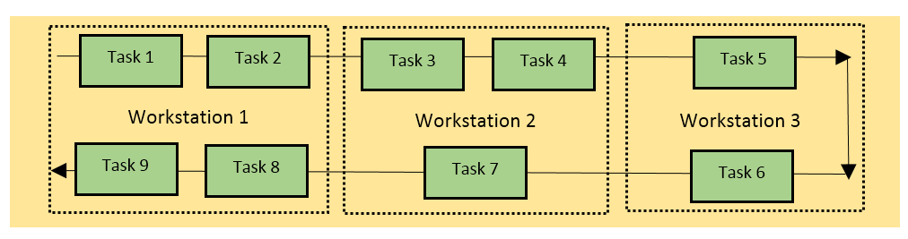
ALB problems based on models & layout
Single Model Assembly Line
Parallel Assembly Line
Multi Model Assembly Line
Mixed Model Assembly Line
Two Sided Assembly Line
U-shaped Assembly Line

Slide 10
ALB - Objectives
Minimize
Maximize
assembly cost
assembly time
cycle time
number of workstation
idle time
workload smoothness
line efficiency
utilization

Slide 11
Complexity of ALB problems
ALB – NP problem
They are intractable
Large size problems can not be solved using Exact algorithms
Heuristic and metaheuristic algorithms are widely used.

Slide 12
Strategies for Solving NP-hard Optimization Problems
Branch-and-Bound → Find exact solution
Heuristic Methods → Deterministic
Metaheuristic Methods → Heuristic + Randomization

Slide 13
Concept of Metaheuristic Algorithms
The word “meta” means higher level while the word “heuristics” means to find. (Glover, 1986)
The operators of metaheuristics
Transition: play the role of searching the solutions (exploration and exploitation).
Evaluation: evaluate the objective function value of the problem in question.
Determination: play the role of deciding the search directions.

Slide 14
Classification of Metaheuristics
The most important way to classify metaheuristics
population-based vs. single-solution-based (Blum and Roli, 2003)
The single-solution-based algorithms work on a single solution, thus the name
Hill Climbing
Simulated Annealing
Tabu Search
The population-based algorithms work on a population of solutions, thus the name
Genetic Algorithm
Ant Colony Optimization
Particle Swarm Optimization
Differential Evolution

Slide 15
Why RALB?
Research on automation and integration of assembly optimization are current research areas.
Researchers started focusing on balancing Robotic Assembly Lines.
Metaheuristic algorithm are useful to get acceptable solutions in reasonable computation time.

Slide 16
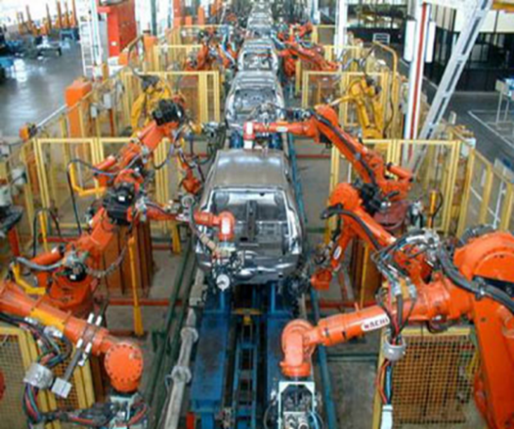
Robotic Assembly Lines
Robots have been extensively used these days in assembly lines called robotic assembly lines (RALs).
Robot can work 24 hours a day without fatigue.
Goals for implementation of robotic assembly lines
high productivity,
quality of product,
manufacturing flexibility
safety
Performance of RALs depends strictly on the quality of its balance.
Robotic assembly line balancing (RALB) also falls under the category of NP-hard .

Slide 17
Literature on RALB-I
Source | Model | Solution Procedure
Rubinovitz (1991) | Minimization of workstations for a given cycle time | Heuristics
Tsai and Yao (1993) | Determine the robot type and number of robots required in each workstation such the standard deviation of workstation outthat put rates of all workstations is minimized. | Integer programming model and simulation adjustment procedure
Kim and Park (1995) | Added constraints such as space to store tools and parts | Mathematical formulation and a cutting plane procedure
Bukchin and Tzur (2000) : | Minimize equipment cost for a predetermined cycle time | Branch and Bound Algorithm

Slide 18
Literature on RALB-II
Source | Model | Solution Procedure
Levitin et al. (2006) | Assignment of tasks to workstations and selection of best fit robot in such way the cycle time is minimized. | Two versions of GA local exchange procedure to improve the quality of the solution
Gao et al.(2009) | Minimize cycle time. | Hybrid Genetic Algorithm
Yoosefelahi et al.(2012) | Minimize the cycle time, robot setup costs and robot costs. | New mixed-integer linear programming model is developed. Multi-objective evolution strategies (MOES) is developed.

Slide 19
State of the Art
ALB | RALB
Rich literature available | Relatively New Problem. Few research papers available
Linear programming, integer programming and branch-and-bound employed. | Only Straight line layout RALB problem with two objectives solved.
Metaheuristics employed to solve ALB problems. | Used branch and bound to solve RALB-I problem
Different objectives are evaluated. | Only GA and Hybrid GA tested on RALB-II problem

Slide 20
Research Scope
Efficient Metaheuristics to solve RALB problems
Different objectives of RALB problems are evaluated.
Different layouts
Straight, U-shaped and two-sided.

Slide 21
Metaheuristics for RALB
Model | Metaheuristic | Objective | Layout
RALB-II | PSO | Minimizing Cycle time | Straight and U-shaped
RALB-Energy | PSO | Minimizing Energy Consumption | Straight and U-shaped
RALB-Cost | PSO & DE | Minimizing Total Assembly Line Cost | Straight and U-shaped
RALB-Efficiency | PSO & DE | Maximizing line efficiency | Straight and U-shaped

Slide 22
Assumptions
Precedence relationship is known and they are not invariable and assembly tasks cannot be subdivided
Duration of an activity depends on the assigned robot.
At a time only one robot can be assigned to a station.
Number of work stations will be equal to number of robots.
Any robot can be assigned to any station to perform certain tasks
Material handling, loading and unloading time, as well as set-up and tool changing time are negligible,or are included in the activity time.
The line is balanced for a single product with different activities to be done to get a final product.

Slide 23
Allocation of Task and Robot to stations
Two methods:
Recursive Method
Consecutive Method
Data required:
Time to complete tasks by the robots
Precedence Relationship of tasks
Number of work stations
Number of robots

Slide 24


Recursive Method
Calculate the Average performance times of robots
Divide the sequence into two parts satisfying H/Q ratio
Here H=M/2 and Q-M-H
Resulting parts is further divided into M=H and M = Q using the same procedure iteratively until M = 1.
Time Ratio value to be calculated and should be as close as H/Q Ratio
Tasks are allocated to the stations and robots are selected which gives minimum execution time

Slide 25
Example Problem
Activities | Performance Time
 | Robot 1 | Robot 2 | Robot 3 | Robot 4 | Average Time(τ)
1 | 81 | 37 | 51 | 49 | 54.5
2 | 109 | 101 | 90 | 42 | 85.5
3 | 65 | 80 | 38 | 52 | 58.75
4 | 51 | 41 | 91 | 40 | 55.75
5 | 92 | 36 | 33 | 25 | 46.5
6 | 77 | 65 | 83 | 71 | 74
7 | 51 | 51 | 40 | 49 | 47.75
8 | 50 | 42 | 34 | 44 | 42.5
9 | 43 | 76 | 41 | 33 | 48.25
10 | 45 | 46 | 41 | 77 | 52.25
11 | 76 | 38 | 83 | 87 | 71
Precedence Graph
Performance times of 11 Activities by 4 Robots

Slide 26
Recursive Method
1 | 3 | 2 | 4 | 5 | 6 | 7 | 9 | 8 | 10 | 11
M=N_{st} =4
Στ=636.75
Position 1
Position 2
Position 5
1 | 3 | 2 | 4 | 5 | 6 | 7 | 9 | 8 | 10 | 11
Στ=523.75
Στ=335.75
Στ=301
Στ=582.5
Στ=113.25
Στ=54.5
M=2
M=2
Στ=301
Στ=335.75
3 | 2 | 4 | 5 | 6 | 7 | 9 | 8 | 10 | 11
2 | 4 | 5 | 6 | 7 | 9 | 8 | 10 | 11
1
6 | 7 | 9 | 8 | 10 | 11
1 | 3 | 2 | 4 | 5
1 | 3
1 | 3 | 2 | 4 | 5
6 | 7 | 9 | 8 | 10 | 11
M=1
M=1
M=1
M=1
Στ=187.75
Στ=121.75
TR ratio:
113.25÷523.75= 0.22 ≠ H/Q
TR ratio:
301÷335.75= 0.9 ≈ H/Q
TR ratio:
54.5÷582.5= 0.09 ≠ H/Q
Στ=121.75
Στ=214
N_{st} = 4
M = N_{st}
H = M/2
Q = M-H
H/Q = 1
1 | 3
2 | 4 | 5
6 | 7
9 | 8 | 10 | 11
1 | 3
2 | 4 | 5
6 | 7
9 | 8 | 10 | 11
T=89 r=3
T=107,r=4
T=116 ,r=2
T=199,r=3

Slide 27

Consecutive Method
Calculate Initial Cycle Time Allocate activities to stations
Tasks are allocated to the stations and robots are selected which gives minimum execution time
Find the preferred set of robots for each station
where
Assign the best robot.
Repeat the procedure until all the activities are assigned.
Increment C0 if all activities are not assigned to a station
Check the cycle time of the preferred robot by adding another activity

Slide 28
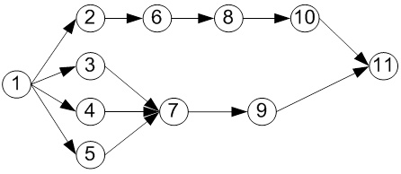
Consecutive Method
1 | 3 | 2 | 4 | 5 | 6 | 7 | 9 | 8 | 10 | 11
STATION 1
STATION 2
STATION3
STATION 4
C_{O}=109
C_{O}=143
ROBOT 1
ROBOT 2
ROBOT 3
ROBOT 4
1 , 3
1
(81)<109
(140)>109
160>109
ROBOT 2
1 , 3
142>109
1
(37)<109
(117)>109
10 , 11
8, 10 , 11
ROBOT 3
1 , 3
1, 3, 2
1
1,3
(51)<109
7, 9, 8
7, 9
(179)>109
181>109
(89)<109
89<109
ROBOT 4
1, 3, 2
1 , 3
1, 3, 2
1
1,3
4, 5, 6
(49)<109
(143)>109
101<109
(101)<109
2,4
5, 6
82<109
T=143
T=136
T=115
T=84
Not assigned to any station
Thus increment C0 until all activities are assigned to
stations

Slide 29
Metaheuristics for RALB – The Two problems
Model | Metaheuristic | Objective | Layout
RALB-II | PSO | Minimizing Cycle time | Straight and U-shaped
RALB-Efficiency | DE | Maximizing line efficiency | Straight and U-shaped

Slide 30
PSO to solve RALB-II

Slide 31
PSO – The Process
Initialize population
Includes position and velocity.
Evaluate fitness of individual particle.
Modify velocities based on personal best and global best.
Terminate on some condition.
Go to step 2.
Proposed by James Kennedy & Russell Eberhart (1995)
Combines self-experiences with social experiences

Slide 32
Initialization- Positions and velocities
Notes:
Here you have another nice search space.
First step: you put some particles on it. You can do it at random or on a regular way, or both. How many? In practice, for most real problems with dimension between 2 and 100, a swarm size of 20 particles works quite good.
There are some mathematical ways to give an estimation, but a bit beyond the scope of this talk. Also, as we will see some variants use an adaptive swarm size.
Second step: you define a velocity for each particle, usually at random. You can set all initial velocities to zero but, experimentally, it is usually not the best choice.
Remember that what we call “velocity” is in fact a move, just because time is discretized.

Slide 33
Modify velocities - based on personal best and global best.
Here I am, now!
pBest
_{gBest}
x_{t}
x_{t+1}
v
New Position !
Notes:
This may be the most important slide of this presentation, for it summarizes the core of the method.
Let’s take a bit time to comment it.
You are a particle. Sorry, I don’t mean you are quite stupid, but it is just to explain how it works.
(By the way, Jim Kennedy has designed a nice game in which you compete with such stupid particles. I have it here, and if we have time, you will see it is almost impossible to beat it.)
You can compute how good is your position (that is to say you can compute the objective function at the place you are). You remember the best position you ever found (and the objective function value). You can ask your neighbours for this information they also have memorized, and choose the best one.
Now, you have three tendancies,
- audacious, following your own way (just using your own velocity)
- conservative, going back more or less towards your best previous position
- sheeplike, going more or less towards your best neighbour
What PSO formalizes is how to combine these tendancies in order to be globally efficient.

Slide 34
Velocity & Position Update
Equation (a):
v[] = c0 *v[]
+ c1 * rand() * (pbest[] - present[])
+ c2 * rand() * (gbest[] - present[]) (in the original method, c0=1, but many researchers now play with this parameter)
Equation (b):
present[] = present[] + v[]

Slide 35
Initial swarm Generation
Swarm size = 25.
Six particles are generated using the following six heuristic rules
maximum rank positional weight
minimum inverse positional weight
minimum total number of predecessors tasks
maximum total number of follower tasks
maximum task time
minimum task time
Remaining Particles are generated randomly meeting the precedence constraints.
Rule | Particles Generated
1 | 1 | 2 | 6 | 3 | 4 | 5 | 7 | 8 | 10 | 9 | 11
2 | 1 | 5 | 4 | 3 | 2 | 7 | 9 | 6 | 8 | 10 | 11
3 | 1 | 2 | 3 | 4 | 5 | 6 | 8 | 10 | 7 | 9 | 11
4 | 1 | 2 | 3 | 4 | 5 | 6 | 7 | 8 | 9 | 10 | 11
5 | 1 | 5 | 2 | 6 | 3 | 4 | 7 | 8 | 10 | 9 | 11
6 | 1 | 4 | 3 | 2 | 5 | 7 | 9 | 6 | 8 | 10 | 11

Slide 36
Initial velocity generation
No: of Activities | Velocity Pairs
0-20 | 4
20-40 | 8
60-80 | 25
80-100 | 30
100-120 | 40
120-140 | 50
140-200 | 65
200-300 | 75
Initial ||v|| is generated randomly
For ||v|| =2 the transpositions can be
v₁ = ((1, 4),(2, 3))

Slide 37
PSO Parameters
Extensive experiments are conducted to find the optimal parameters.
Sample data sets were used to find the best parameters
parameters tested:
Number of iterations: 10,15,25,30
Learning coefficients: c1=1, 2, 3; c2=1, 2, 3 and c3= 1, 2, 3

Slide 38
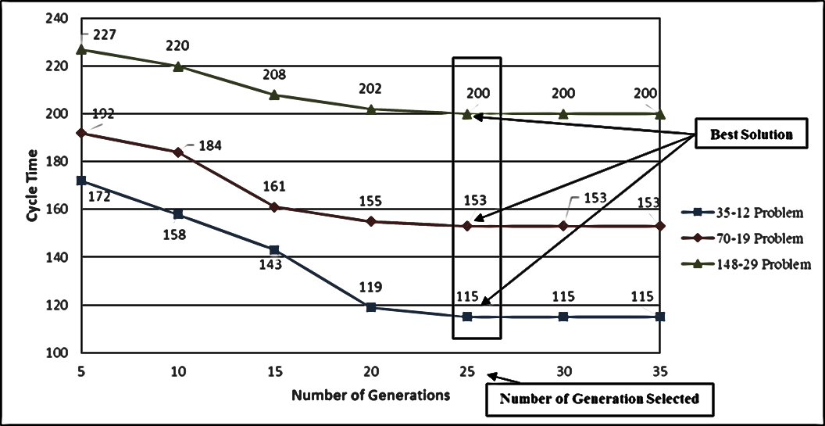
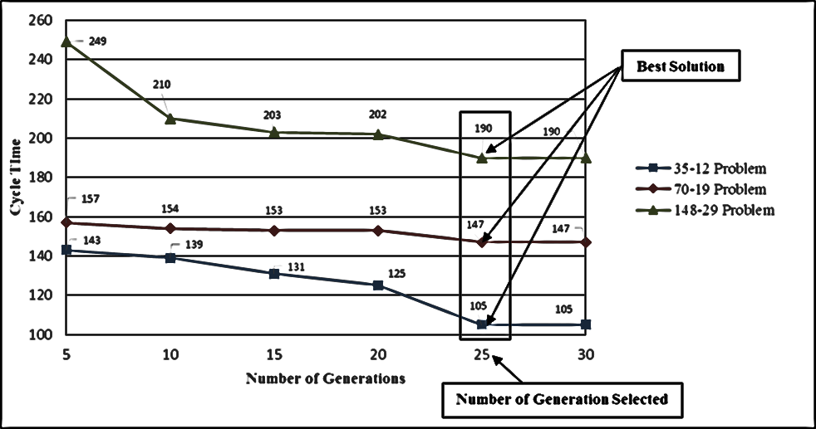
Parameter Analysis- Stopping Condition
Consecutive allocation procedure
Recursive allocation procedure

Slide 39
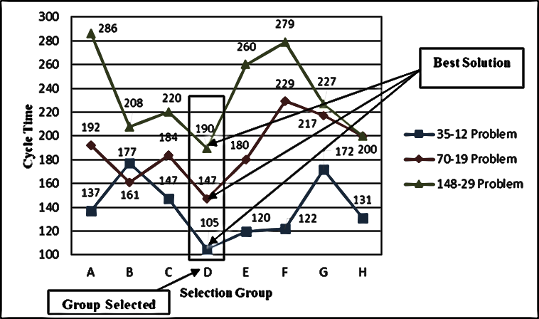
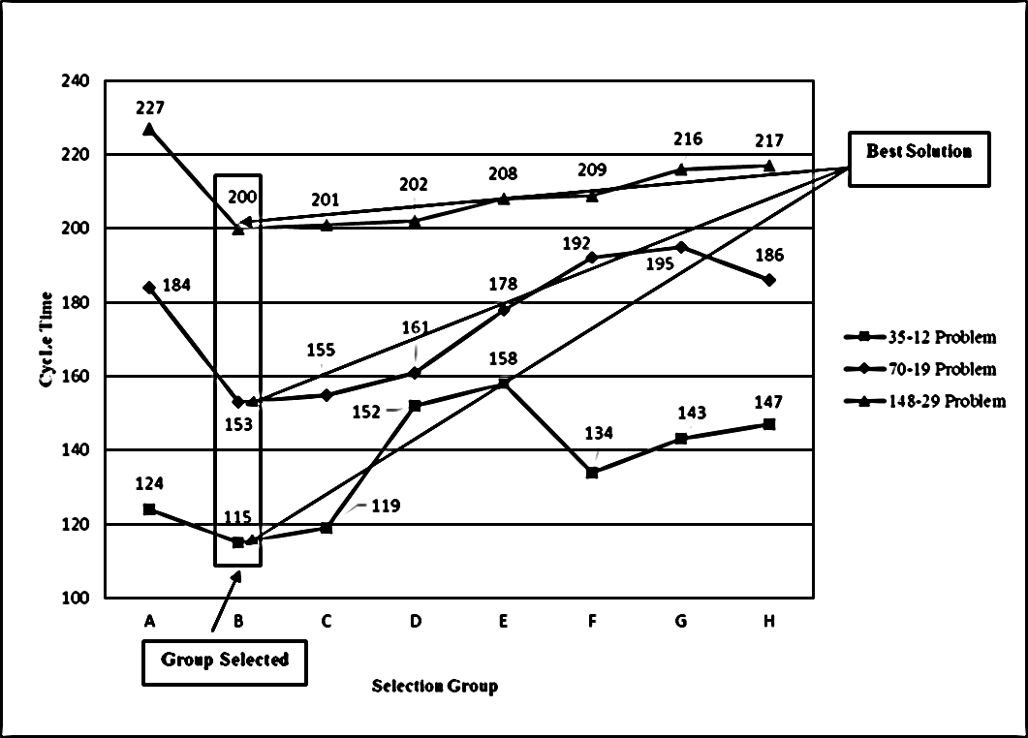
Parameter Analysis- Acceleration Coefficients
Consecutive Allocation Procedure
Recursive Allocation Procedure
Presentation title
1/6/2022

Slide 40
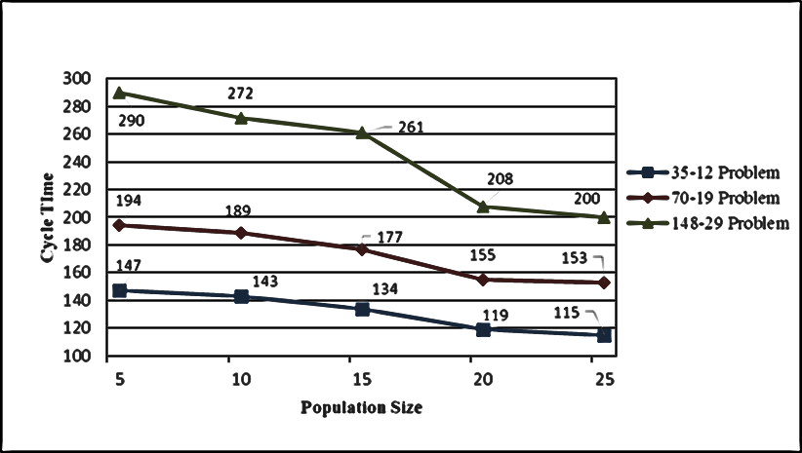
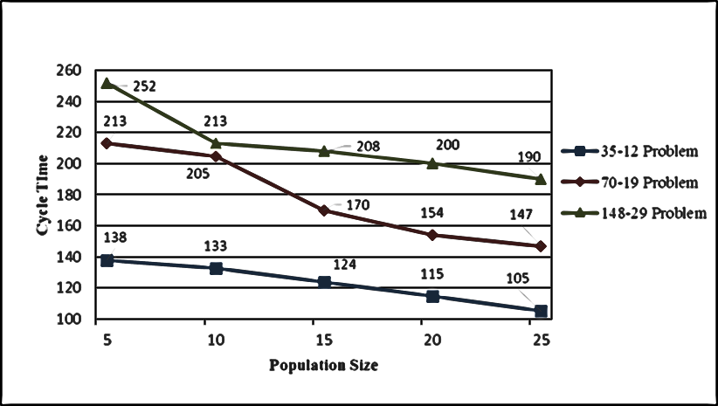
Parameter Analysis- Population Size
Recursive Allocation Procedure
Consecutive Allocation Procedure

Slide 41
Datasets
http://www.assembly-line-balancin.de/
Problem size ranges from 25 tasks to 297 tasks.
Problem Size | Source | Reference
25 | Randomly Generated | (Rosenberg and Ziegler, 1992)
35 | Assembly of an auto engineer cradle | (Gunther et al., 1983)
53 | Assembly of Hot Tank | (Hahn, 1972)
70 | Electronic Industry | (Tonge, 1960)
89 | Assembly of Refrigerator | (Lutz, 1974)
111 | Mixed Assembly Line | (Arcus, 1965)
148 | Assembly of small Utility Vehicles | (Bartholdi, 1993)
297 | Assembly of an Engine | (Scholl, 1999)

Slide 42
Performance Evaluation – Straight Line
Problem No: | Problem Dataset | Cycle Time |  |  |  | Problem No: | Problem Dataset | Cycle Time
 |  | HGA | Cplex* | PSO Recursive | PSO Consecutive |  |  | HGA | Cplex* | PSO Recursive | PSO Consecutive
1 | 25-3 | 503 | 503 | 503 | 503 | 17 | 89-8 | 494 | N/A | 479 | 463
2 | 25-4 | 327 | 292 | 327 | 327 | 18 | 89-12 | 370 | N/A | 345 | 355
3 | 25-6 | 213 | 200 | 208 | 208 | 19 | 89-16 | 236 | N/A | 234 | 234
4 | 25-9 | 123 | 109 | 114 | 114 | 20 | 89-21 | 205 | N/A | 201 | 176
5 | 35-4 | 449 | 341 | 347 | 344 | 21 | 111-9 | 557 | N/A | 551 | 526
6 | 35-5 | 344 | 329 | 338 | 336 | 22 | 111-13 | 319 | N/A | 316 | 316
7 | 35-7 | 222 | 201 | 219 | 214 | 23 | 111-17 | 257 | N/A | 257 | 254
8 | 35-12 | 113 | 106 | 115 | 105 | 24 | 111-22 | 192 | N/A | 190 | 185
9 | 53-5 | 554 | 449 | 538 | 454 | 25 | 148-10 | 600 | N/A | 593 | 603
10 | 53-7 | 320 | 283 | 304 | 301 | 26 | 148-14 | 427 | N/A | 426 | 420
11 | 53-10 | 230 | 221 | 228 | 224 | 27 | 148-21 | 300 | N/A | 299 | 277
12 | 53-14 | 162 | 142 | 153 | 146 | 28 | 148-29 | 202 | N/A | 200 | 190
13 | 70-7 | 449 | 394 | 448 | 431 | 29 | 297-19 | 646 | N/A | 767 | 608
14 | 70-10 | 272 | 245 | 266 | 269 | 30 | 297-29 | 430 | N/A | 451 | 397
15 | 70-14 | 204 | N/A | 204 | 200 | 31 | 297-38 | 344 | N/A | 350 | 295
16 | 70-19 | 154 | N/A | 153 | 147 | 32 | 297-50 | 256 | N/A | 257 | 245

Slide 43
Observations
Recursive and Consecutive approaches converged to same solution for the first four problems.
Recursive procedure could not obtain better results for large size problem (297 task problems).
Consecutive procedure yields better results for the 30 out of 32 test problems.
Cplex could solve only small size problems using.

Slide 44
U-shaped Robotic Assembly Line Balancing (RUALB)
No research reported so far.
Problem is further complicated with addition of robots and U-shaped configuration.
RUALB is also NP-hard.
A heuristic based on the consecutive procedure is developed for allocation of tasks and robot.
Cycle time minimization is considered.

Slide 45
Task and Robot Allocation
Similar to consecutive procedure.
Procedure starts with an initial cycle time of the assembly line, C₀.
Allocate maximum number of tasks at each workstation.
Tasks are allocated to the workstation by moving forward and backward through the precedence diagram.
Best robots to perform the tasks allotted to the workstations are allotted.
C₀ incremented by ‘one’ if certain tasks cannot be assigned within the given initial C₀ value.
Procedure continues until all the tasks are assigned.

Slide 46
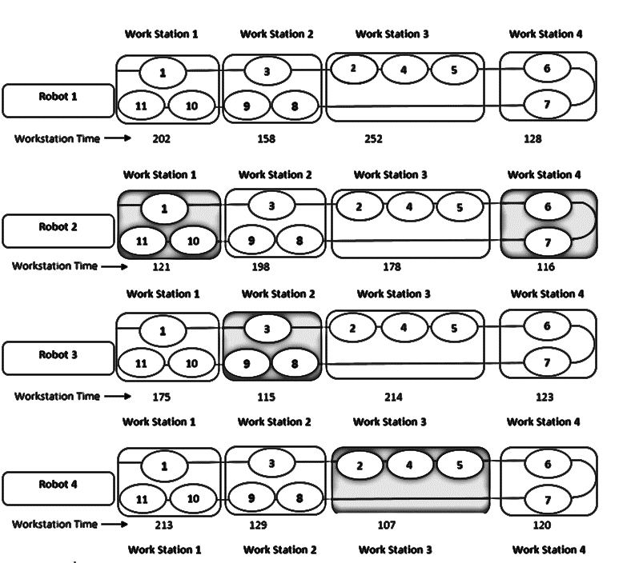
Task and Robot Allocation
Allocation in a U-shaped Robotic Assembly Line
1 | 3 | 2 | 4 | 5 | 6 | 7 | 9 | 8 | 10 | 11

Slide 47
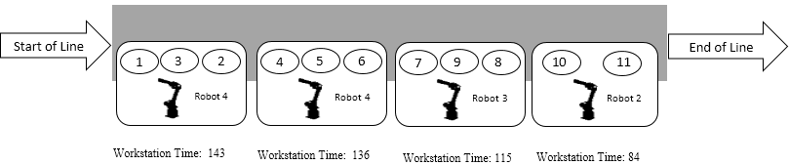
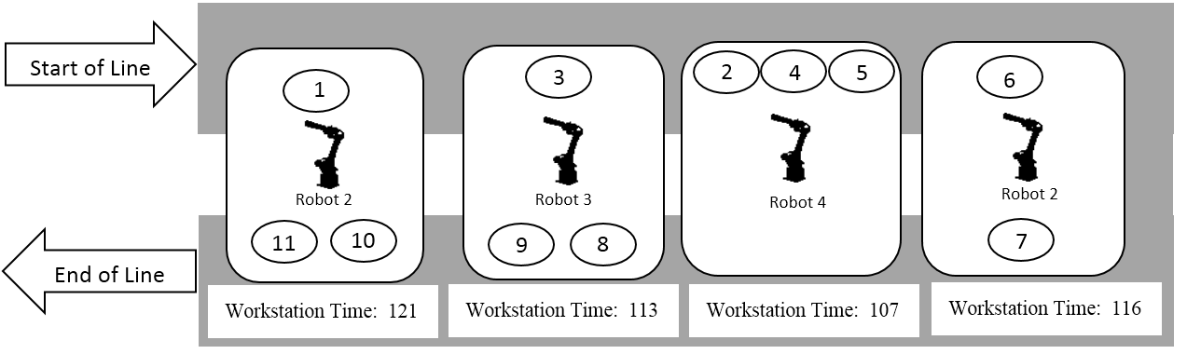
Straight and U-shaped Layout
Straight Layout
U-shaped Layout

Slide 48
Performance Evaluation – Straight & U-Shaped
No | Problem | Cycle Time |  |  | Problem No: | Problem | Cycle Time
 |  | Straight Line | U-shaped | Percentage Deviation |  |  | Straight Line | U-shaped | Percentage Deviation
1 | 25-3 | 503 | 500 | 0.5 | 17 | 89-8 | 494 | 496 | -0.49
2 | 25-4 | 327 | 318 | 2.75 | 18 | 89-12 | 370 | 326 | 11.89
3 | 25-6 | 213 | 188 | 11.73 | 19 | 89-16 | 236 | 224 | 5.08
4 | 25-9 | 123 | 114 | 7.31 | 20 | 89-21 | 205 | 174 | 15.12
5 | 35-4 | 449 | 355 | 20.93 | 21 | 111-9 | 557 | 545 | 2.15
6 | 35-5 | 344 | 332 | 3.48 | 22 | 111-13 | 319 | 320 | -0.313
7 | 35-7 | 222 | 221 | 0.45 | 23 | 111-17 | 257 | 256 | 0.38
8 | 35-12 | 113 | 103 | 8.84 | 24 | 111-22 | 192 | 186 | 3.12
9 | 53-5 | 554 | 459 | 17.14 | 25 | 148-10 | 600 | 629 | -4.83
10 | 53-7 | 320 | 286 | 10.62 | 26 | 148-14 | 427 | 421 | 1.40
11 | 53-10 | 230 | 220 | 4.34 | 27 | 148-21 | 300 | 283 | 5.66
12 | 53-14 | 162 | 148 | 8.64 | 28 | 148-29 | 202 | 187 | 7.42
13 | 70-7 | 449 | 447 | 0.44 | 29 | 297-19 | 646 | 597 | 7.58
14 | 70-10 | 272 | 272 | 0 | 30 | 297-29 | 430 | 394 | 8.37
15 | 70-14 | 204 | 211 | -3.43 | 31 | 297-38 | 344 | 293 | 14.8
16 | 70-19 | 154 | 144 | 6.49 | 32 | 297-50 | 256 | 224 | 12.5

Slide 49
Observation
PSO is proposed to solve RALB for straight & U-shaped layout.
Tasks and robot assignment in the U-shaped configuration are highly complex.
Cycle time for U-shaped layout is lower than the straight layout.

Slide 50
DE to solve RALB-Efficiency

Slide 51
RALB-Efficiency
Efficiency is a crucial factor in industrial production lines to improve the utilization of resources.
Industries would produce more in shorter time and meet the demand of the customers.
Maximizing line efficiency is the key to profitability.

Slide 52
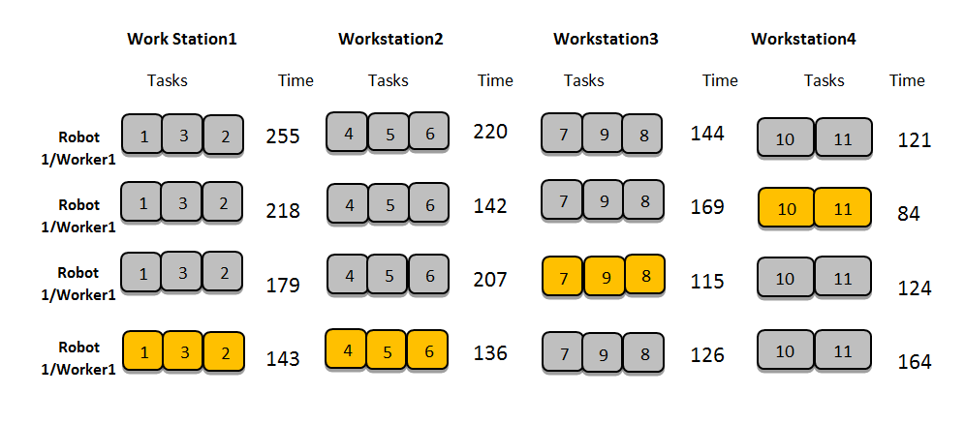
Line Efficiency & Smoothness Index
Line Efficiency
Smoothness Index

Slide 53
Differential Evolution
Start
Storn, R., & Price, K. (1997). Differential evolution–a simple and efficient heuristic for global optimization over continuous spaces. Journal of global optimization, 11(4), 341-359.
Population of D-dimensional parameter vectors → Target vectors
Mutation → Donor vectors
Crossover → Trial vectors
Selection
Stopping criterion met?
No
Yes
Stop

Slide 54
Population Initialization
Methods | Target Vectors Genrated
Maximum Rank Positional Weight | 1 | 2 | 6 | 3 | 4 | 5 | 7 | 8 | 10 | 9 | 11
Minimum Inverse Positional Weight | 1 | 5 | 4 | 3 | 2 | 7 | 9 | 6 | 8 | 10 | 11
Minimum Total Number Of Predecessors Tasks | 1 | 2 | 3 | 4 | 5 | 6 | 8 | 10 | 7 | 9 | 11
Maximum Total Number of Follower Tasks | 1 | 2 | 3 | 4 | 5 | 6 | 7 | 8 | 9 | 10 | 11
Maximum Task Time | 1 | 5 | 2 | 6 | 3 | 4 | 7 | 8 | 10 | 9 | 11
Minimum Task Time | 1 | 4 | 3 | 2 | 5 | 7 | 9 | 6 | 8 | 10 | 11

Slide 55


Mutation
$${\hat{x}}_{i,G}=x_{r1,G}+F(x_{r2,G}−x_{r3,G})$$
Difference vector
Donor vector
Base vector
Mutation scale factor $∈[0,2]$
New vector
Base vector
Difference vector

Slide 56


Crossover
The mixture of elements between donor vectors and target vectors to create trial vectors.
Binomial → element-by-element:
$$y_{i,k}^{j}=\left\{ \begin{matrix}{\hat{x}}_{i,k}^{j} \text{if} R^{j} ≤C_{R} or j=I_{i} \\ x_{i,k}^{j} \text{if} R^{j}>C_{R} and j ≠I_{i}\end{matrix}\right.$$
Donor vector element
Trial vector element
Target vector element
Crossover rate $∈[0,1]$

Slide 57
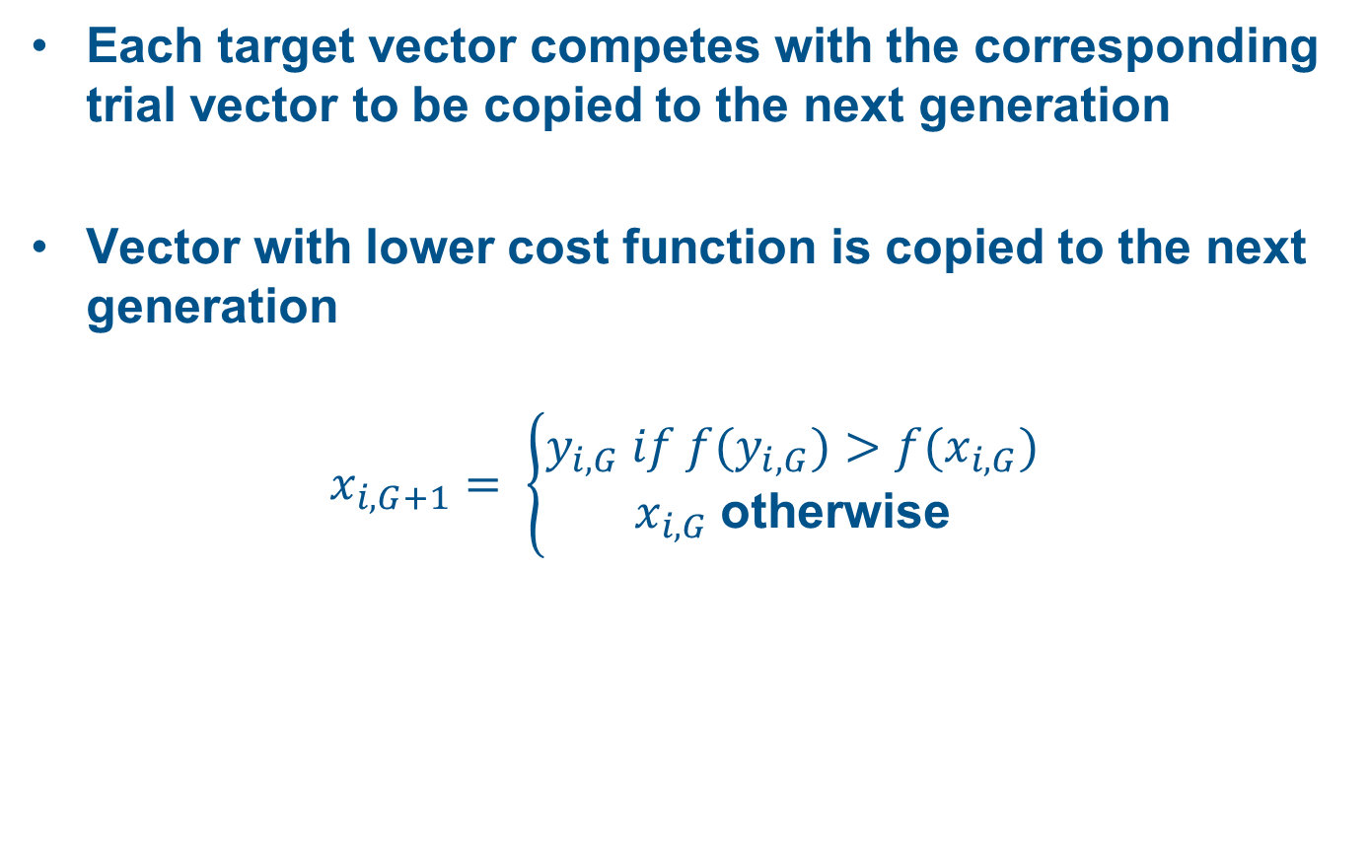
Selection
Each target vector competes with the corresponding trial vector to be copied to the next generation
Vector with lower cost function is copied to the next generation
$$x_{i,G+1}= \left\{\begin{matrix}y_{i,G} if f(y_{i,G})>f(x_{i,G}) \\ x_{i,G} \text{otherwise}\end{matrix}\right.$$

Slide 58
DE Parameters
Mutation factor: 0.5
Crossover Rate: 0.7
Population Size:25
Number of Generations: 30

Slide 59
Results
Problem | Straight Line RALB |  |  | U-shaped RALB
 | LE (%) | c | SI | LE | c | SI
25-3 | 97.3 | 503 | 18.6 | 99.1 | 500 | 6.02
25-4 | 88.6 | 329 | 40.4 | 91.5 | 318 | 33.5
25-6 | 88.2 | 208 | 29.3 | 96.9 | 183 | 7.3
25-9 | 84.5 | 114 | 23.3 | 88.9 | 109 | 15.8
35-4 | 98.0 | 347 | 9.6 | 98.6 | 345 | 3.6
35-5 | 93.0 | 335 | 31.9 | 97.4 | 334 | 11.8
35-7 | 92.0 | 219 | 21.7 | 94.8 | 215 | 13.5
35-12 | 82.3 | 115 | 24.5 | 87.3 | 106 | 17.8
53-5 | 92.1 | 485 | 45.2 | 97.3 | 459 | 16.7
53-7 | 93.4 | 304 | 26.0 | 93.8 | 286 | 21.8
53-10 | 91.4 | 234 | 24.3 | 93.7 | 220 | 16.4
53-14 | 82.2 | 161 | 32.0 | 90.0 | 148 | 18.3
70-7 | 95.0 | 447 | 29.2 | 97.4 | 427 | 12.2
70-10 | 93.8 | 272 | 21 | 94.0 | 266 | 22
70-14 | 87.6 | 211 | 29.6 | 92.8 | 199 | 18.0
70-19 | 87.5 | 144 | 23.5 | 89.2 | 140 | 17.9

Slide 60
Results
Problem | Straight Line RALB |  |  | U-shaped RALB
 | LE (%) | c | SI | LE | c | SI
89-8 | 82.3 | 486 | 35.6 | 84 | 475 | 19.9
89-12 | 94.3 | 317 | 22.6 | 96 | 315 | 16.4
89-16 | 90.8 | 247 | 41.1 | 98.2 | 224 | 22.03
89-21 | 88.2 | 174 | 23.1 | 88.6 | 172 | 25
111-9 | 97.8 | 523 | 16.9 | 96.8 | 520 | 23.6
111-13 | 95.6 | 321 | 19.9 | 94.4 | 319 | 23.5
111-17 | 93.2 | 247 | 19.7 | 93.8 | 242 | 18.3
111-22 | 91.7 | 183 | 18.0 | 90.1 | 181 | 22.1
148-10 | 96.2 | 641 | 32.2 | 96.7 | 629 | 26.3
148-14 | 96.4 | 420 | 18.2 | 94.0 | 418 | 32.2
148-21 | 94.5 | 273 | 15.5 | 92.7 | 275 | 22.5
148-29 | 92.8 | 189 | 18.0 | 89.9 | 187 | 22.5
297-19 | 97.1 | 594 | 20.7 | 96.4 | 589 | 24.5
297-29 | 93.3 | 399 | 31.3 | 93.4 | 390 | 34.2
297-38 | 91.2 | 305 | 31.0 | 93.6 | 291 | 22.9
297-50 | 92.4 | 225 | 19.8 | 90.9 | 222 | 22.7

Slide 61
Observations
U-shaped Robotic assembly line produces better line efficiency and lower cycle time for all the small datasets.
Straight robotic assembly line reported better efficiency for large datasets.
This could be due to the variation in station time is lower when assembled through straight line.

Slide 62
Conclusions
U-shaped robotic assembly line produces higher line efficiency compared to that of straight robotic assembly line for small size datasets.
For large size datasets straight robotic assembly line generates higher line efficiency.
When the cycle time is compared U-shaped robotic assembly line performs better than the straight robotic assembly line.
DE parameters are selected through a series of fine tuning and these parameters are used to find the solution reported here.

Slide 63
Computational Time
 |  | CPU TIME (sec)
N_{a} | N_{st} | GA+ Recursive | GA+ Consecutive | Hybrid GA | Proposed Method
25 | 3 | 1 | 3 | 5 | 3.5
 | 4 | 1 | 4 | 5 | 3.9
 | 6 | 2 | 4 | 6 | 4.2
 | 9 | 2 | 5 | 7 | 4.8
35 | 4 | 2 | 8 | 12 | 7.7
 | 5 | 2 | 11 | 16 | 7.9
 | 7 | 3 | 14 | 22 | 7.9
 | 12 | 3 | 17 | 30 | 8.3
53 | 5 | 3 | 15 | 17 | 22
 | 7 | 3 | 17 | 21 | 22.4
 | 10 | 4 | 19 | 27 | 22.7
 | 14 | 4 | 20 | 35 | 22.9
70 | 7 | 5 | 22 | 40 | 46.4
 | 10 | 7 | 26 | 53 | 47.3
 | 14 | 9 | 32 | 64 | 47.8
 | 19 | 11 | 43 | 82 | 48.2
Computation time for
25-70 tasks
Table contains the compared result of the average computational time (CPU Time) of all the methods.
Proposed research finds the solution faster for small sized problems.

Slide 64
Computational Time
 |  | CPU TIME (sec)
N_{a} | N_{st} | GA+ Recursive | GA+ Consecutive | Hybrid GA | Proposed Method
89 | 8 | 6 | 25 | 46 | 88.7
 | 12 | 8 | 29 | 58 | 89.4
 | 16 | 10 | 37 | 71 | 92.1
 | 21 | 13 | 46 | 89 | 93.2
111 | 9 | 7 | 83 | 157 | 167.2
 | 13 | 9 | 82 | 192 | 167.6
 | 17 | 11 | 109 | 229 | 168.2
 | 22 | 14 | 142 | 271 | 171.2
148 | 10 | 13 | 113 | 240 | 381.1
 | 14 | 16 | 151 | 297 | 385.5
 | 21 | 23 | 164 | 332 | 390.4
 | 29 | 26 | 227 | 417 | 390.9
297 | 19 | 37 | 425 | 824 | 1123.5
 | 29 | 40 | 459 | 907 | 1135.9
 | 38 | 43 | 493 | 996 | 1140.2
 | 50 | 45 | 549 | 1103 | 1148.7
Computation time for
89-297 tasks

Slide 65
Conclusion
Main intent of this work is to develop an efficient PSO for rALB.
Solution obtained provides the best task assignment to the stations and selecting the best robot.
A local exchange procedure is implemented to improve the solution obtained from PSO.
Performance of the proposed PSO is performing better than GA with recursive, GA with consecutive and hybrid GA available in terms of cycle time minimization
Algortihm gives optimal solutions for very small-size problems in an acceptable time span.
Notes:
P(min) set to 0.1
Initially P(ai) set to 0.1
After calc of P(ai), a selection method is used to select the action

Slide 66
SCM and ALB
Optimization of Strategic and Tactical decisions simultaneously.
SCN design – strategic decision
ALB – tactical decision
Very few literature available
Few formulations are reported in the literature
Lot of scope to work on the integrated approach

Slide 67
Future Research Directions
Efficient heuristics and meta-heuristic approaches could be developed to solve these NP-hard problems.
Study on
disassembly lines
different types of networks: reverse, closed-loop or decentralized supply chains
Simultaneously to provide environmental profits.
Application of these planning models to real case studies.

Slide 68

End of Presentation
Thank you for your patience and attention

